Slide 1
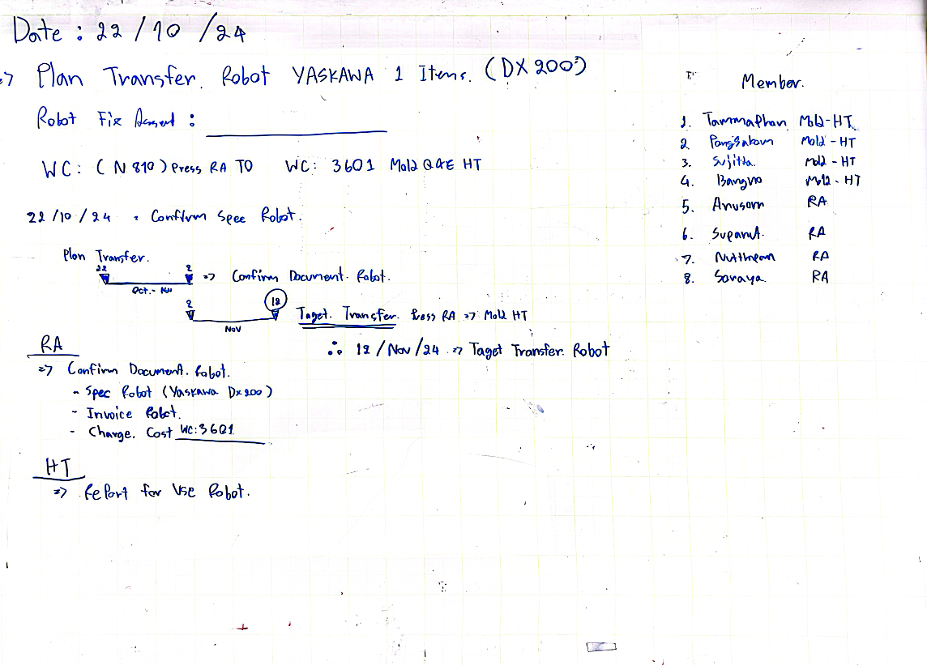

Slide 2
HT-MFG2 Mold
2
Project : Full Automation Production 1001T

Slide 3
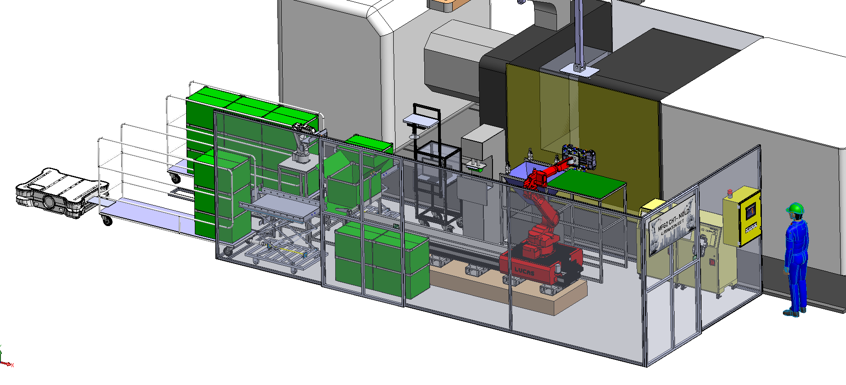
HT-MFG2 Mold
3
Overview “Automation New ” : 1 Items
Full Automation Production 1001 T
Robot of CHT-RA
Project | Purpose
1. Full auto-production | Cost down : Sho-JIN / Katsu-JIN

Slide 4
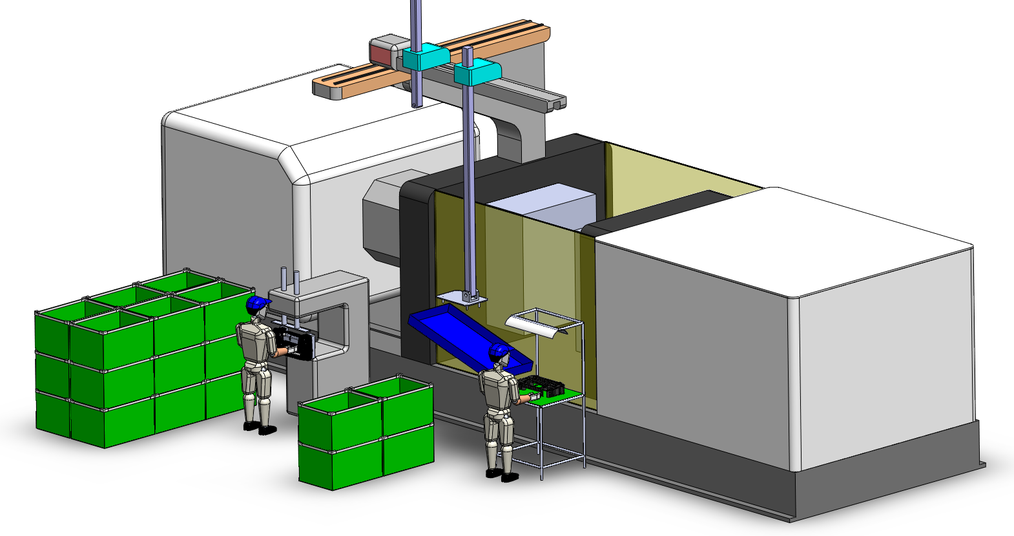
HT-MFG2 Mold
4
Compare process
Before
Process |  | Manpower
1 | Cutting Gate | 1
2 | PAD and Appearance Check and Packing | 1
Process PAD Printing and Packing Part to Box
Process Cutting Gate
After
Process |  | Manpower
1 | Cutting Gate | 0
2 | PAD and Appearance Check and Packing | 0
Sho-jin = 2 Person/Shift

Slide 5
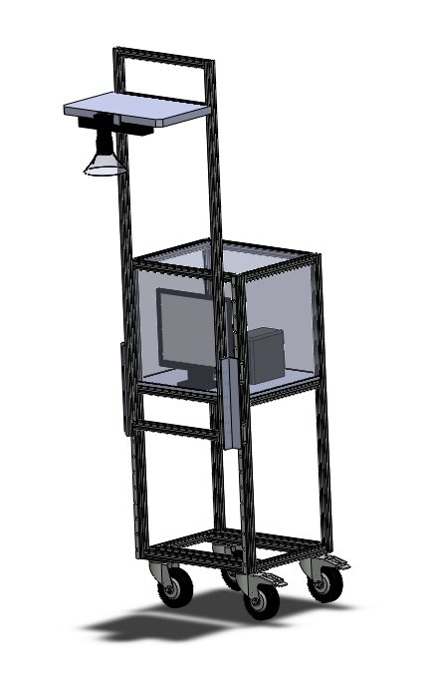
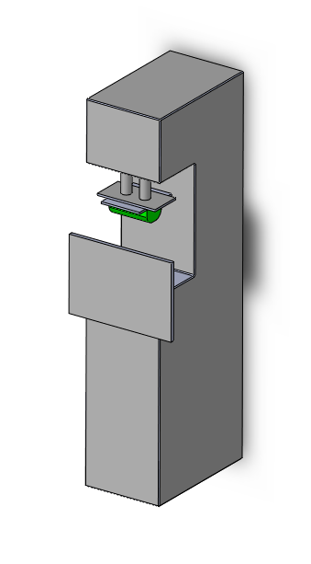
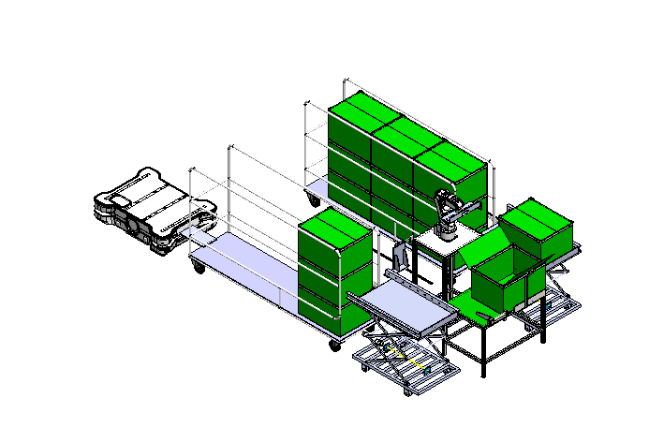
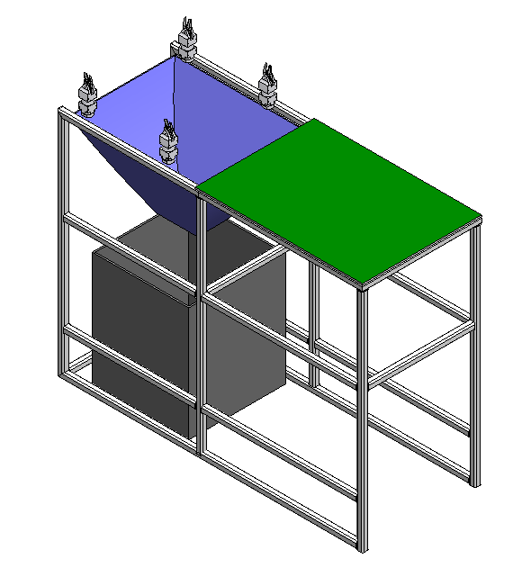
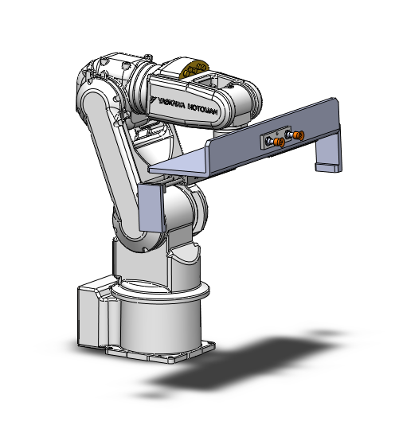
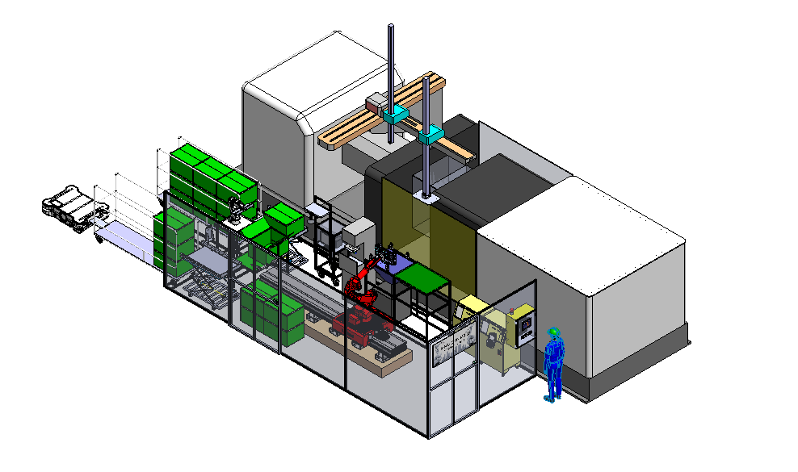
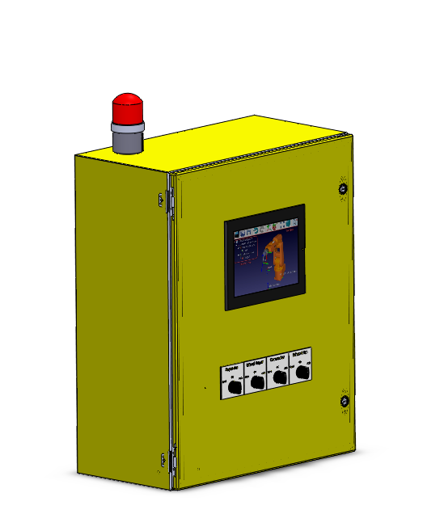
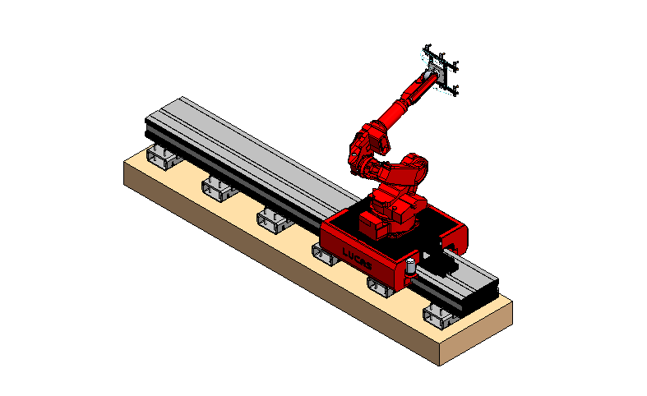
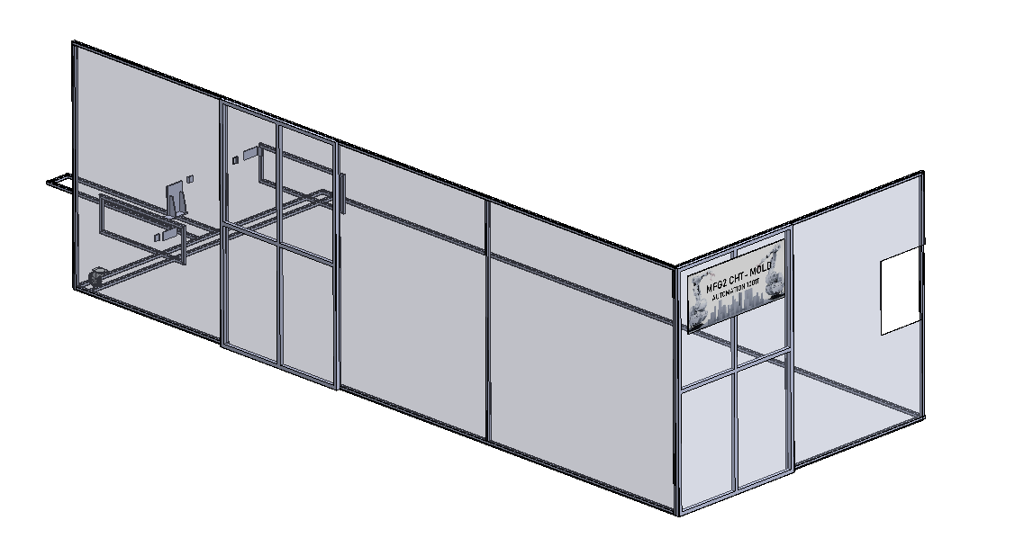
HT-MFG2 Mold
5
All Process
6.Status Packing Automation and AGV Auto
5.Status CAMERA CHECK Automation
4.Status PAD Printing Automation
7.Robot Packing part
3.Status Cut Gate Automation
8.Robot Move Part
2.Electrical Control
1.Cover Safety

Slide 6
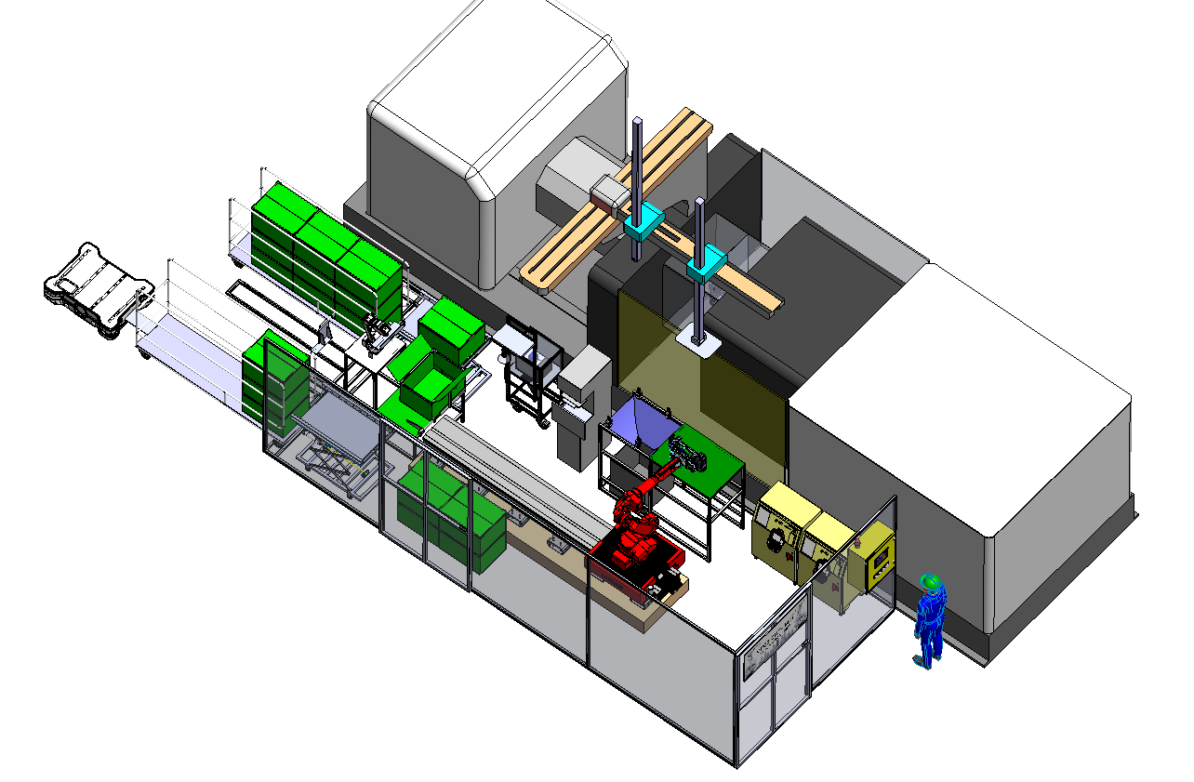
HT-MFG2 Mold
6
Function working Automation 1001T
2.Process Packing
1.Process About Part

Slide 7
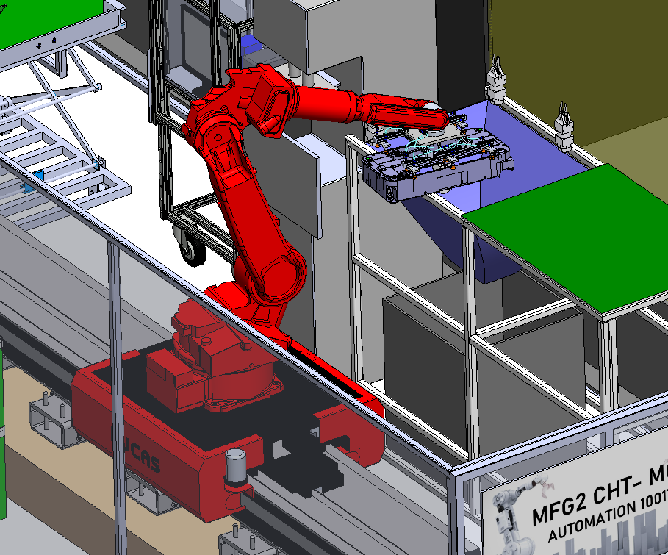

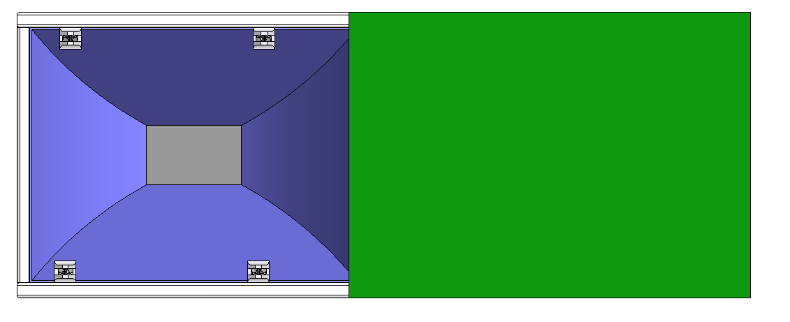
HT-MFG2 Mold
7
1. Full auto-production 1001T – Automation Cut Gate
Step of Automation Cut Gate
Robot of machine injection input Part at table automation cut gate
Robot 7 axis move part to Auto Nipper at position gate at part
Function
Injection Machine
PART
Estimate Time = 5-10 Sec.
PART
ROBOT

Slide 8
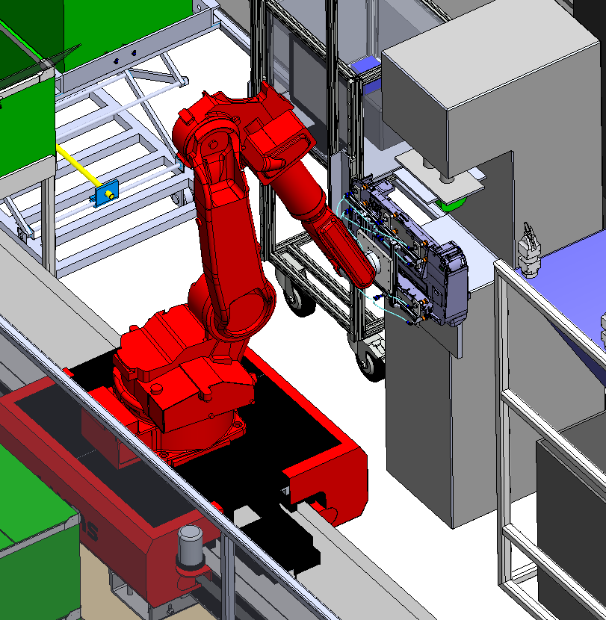
HT-MFG2 Mold
8
2. Full auto-production 1001T – Automation PAD
Step of Automation PAD
Robot of machine injection input Part at table automation cut gate
Robot 7 axis move part to Auto Nipper at position gate at part
Robot Move Part at position machine PAD
Function
Injection Machine
PART
PAD
PART
Estimate Time = 5-10 Sec.
ROBOT

Slide 9
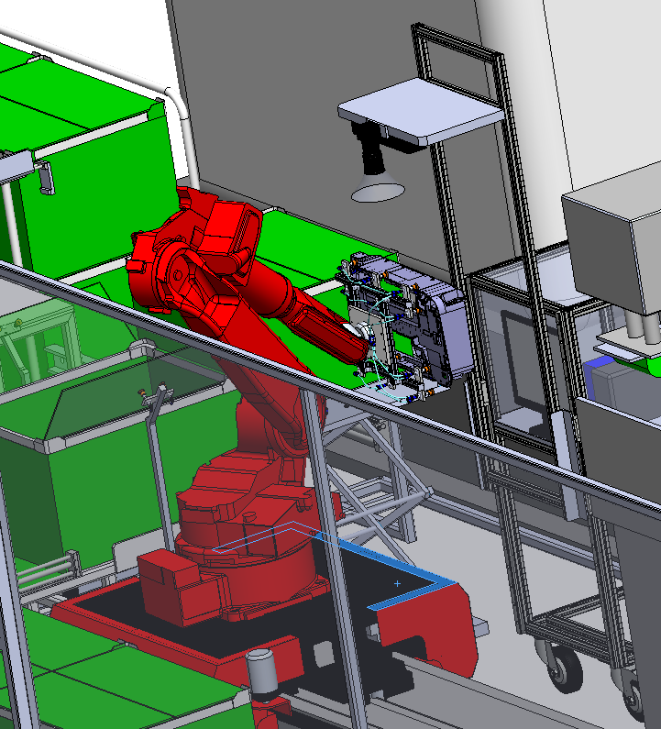
HT-MFG2 Mold
9
3. Full auto-production 1001T – Automation Camera check
Step of Automation PAD
Robot of machine injection input Part at table automation cut gate
Robot 7 axis move part to Auto Nipper at position gate at part
Robot Move Part at position machine PAD
Robot Move part to Camera Check Auto
Function
Injection Machine
PART
CAMERA
PAD
PART
Estimate Time = 5 Sec.
ROBOT

Slide 10
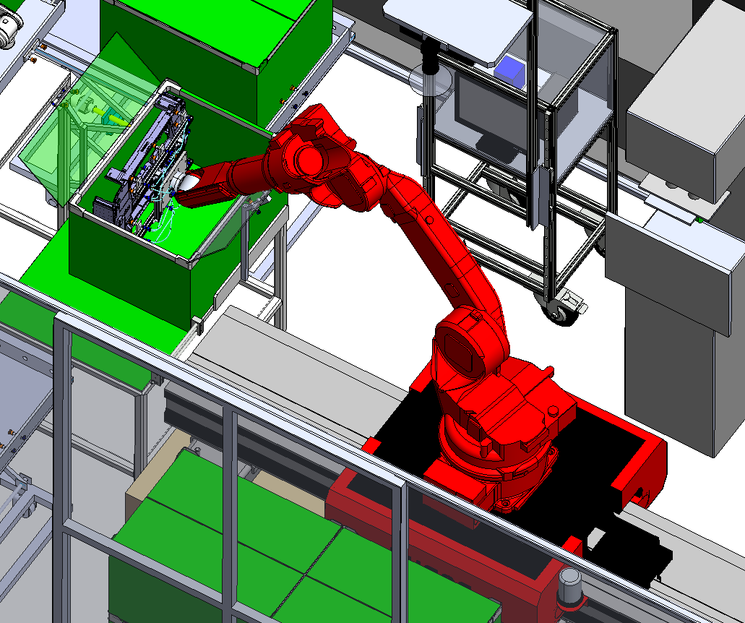
HT-MFG2 Mold
10
4. Full auto-production 1001T – Move Part to box Packing
Step of Automation PAD
Robot of machine injection input Part at table automation cut gate
Robot 7 axis move part to Auto Nipper at position gate at part
Robot Move Part at position machine PAD
Robot Move part to Camera Check Auto
Function
Injection Machine
PART
CAMERA
PAD
PART
Estimate Time = 5 Sec.
ROBOT

Slide 11
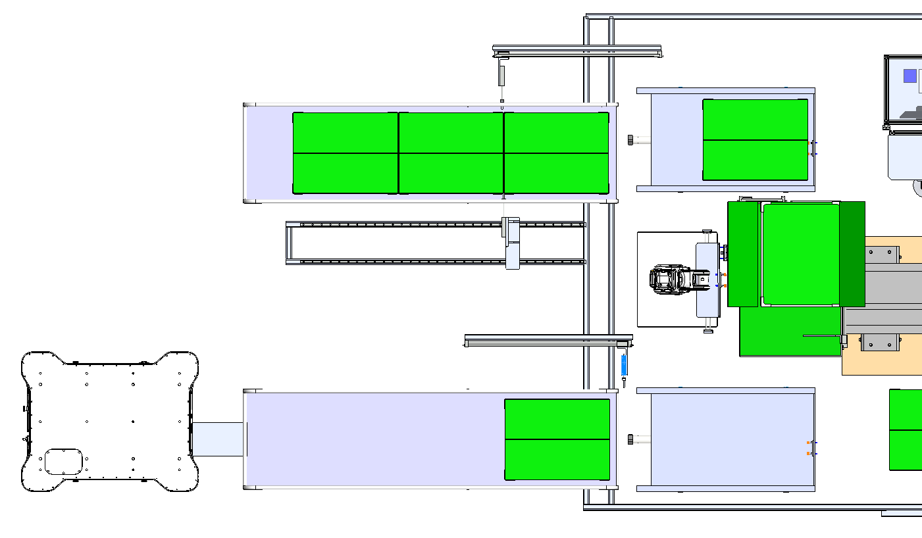
HT-MFG2 Mold
11
5. Full auto-production 1001T – Packing and Open BOX
Step of Packing and Open Box
1.Move Box To Lift in
2.Robot Move Box to Table Open Box
3.Robot Open Box
4. Part OK Robot Move Box To Lift Out
Move Box
Input Box Daisha
Move Box
Stop Box
Open Box
Part OK Move To Store By AGV
Move Box

Slide 12
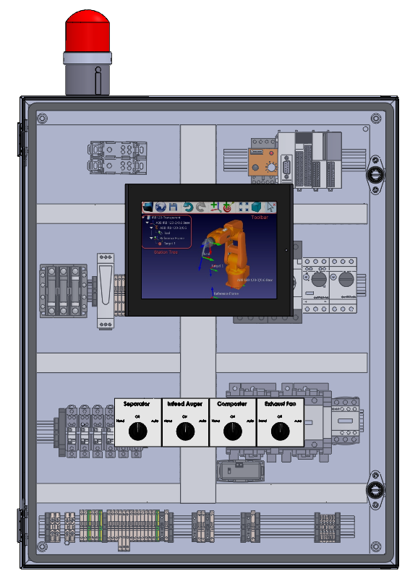
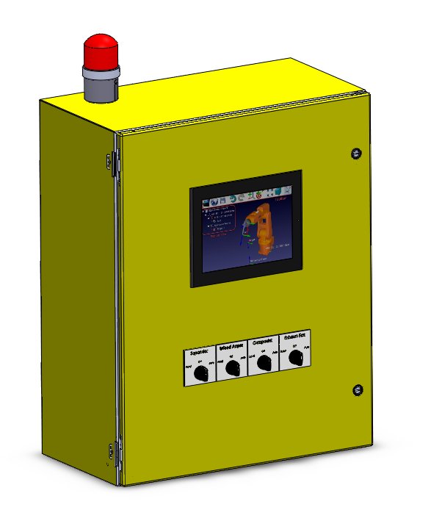
HT-MFG2 Mold
12
1. Full auto-production 1001T – Electrical Control

Slide 13
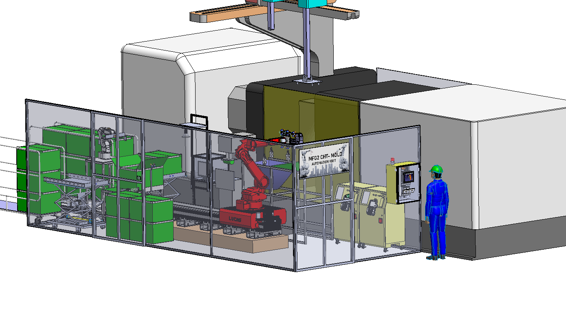
HT-MFG2 Mold
13
1. Full auto-production 1001T – Cover safety

Slide 14
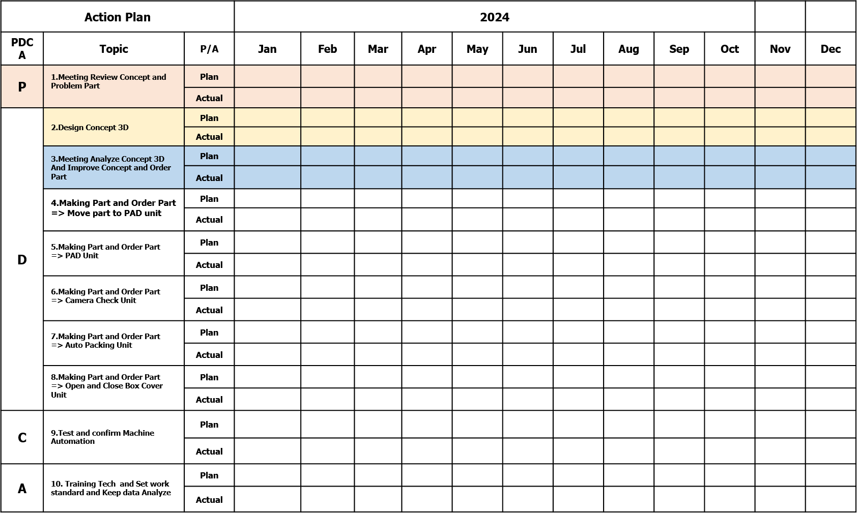
Action Plan / Schedule
HT-MFG2 Mold
14
5
Meeting and review Problem Part
Result =OK
5
Now
8
15
Design concept function result = OK
8
15
8
15
8
15
Design concept function result = OK
27
25
27
25
Design concept function result = OK (USE MACHINE PAD MODIFY AUTO
17
18
17
18
4
29
4
29
1
26
2
6
27
30
4
31

Slide 15
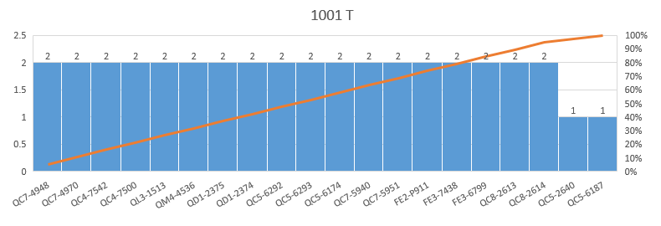
HT-MFG2 Mold
15
Detail Part
Detail Run | Q'ty Part
0.5 | 2
1 | 5
2 | 1
3 | 9
7 | 2
14 | 1
Machine 1001T Injection part all 20 Items. (Use Operator = 2 Person/Part)
Summary Operator 2 Ship = 4 Person
MC | No. | Part No./ Unit No. | Master No./ Family | Material | unit | Opreator | special set | L/T (Day)
1001J | 1 | QC7-4948 | QC4-7500 | PS-HI STYRON 438 DIM BLACK PSM 32384-33 | KD | 2 |  | 1
 | 2 | QC7-4970 | QC4-7542 | PS-HI STYRON 438 DIM BLACK PSM 32384-33 | KD | 2 |  | 1
 | 3 | QC4-7542 |  | PS-HI STYRON 438 DIM BLACK PSM 32384-33 |  | 2 |  | 0.5
 | 4 | QC4-7500 |  | PS-HI STYRON 438 DIM BLACK PSM 32384-33 |  | 2 |  | 0.5
 | 5 | QL3-1513 | QC6-6991 | PS-HI STYRON 438 DIM BLACK PSM 32384-33 | RA | 2 |  | 1
 | 6 | QC5-2640 |  | PSHI STYRON A-TECH 1180 DIM BLACK PSM 27790-33 |  | 1 | 2 Sides | 3
 | 7 | QM4-4536 | QC5-2678 | PSHI STYRON A-TECH 1180 DIM BLACK PSM 27790-33 |  | 2 |  | 3
 | 8 | QC5-6187 |  | PSHI STYRON A-TECH 1180 DIM BLACK PSM 27790-33 |  | 1 |  | 3
 | 9 | QD1-2375 |  | ABS GA-701 GLEAM BLACK HBM-25A769-5 |  | 2 |  | 3
 | 10 | QD1-2374 |  | ABS GA-701 GLEAM BLACK HBM-25A769-5 |  | 2 | 2 Sides | 3
 | 11 | QC5-6292 | QD1-2375 | ABS GA-701 TITANIUM WHITE |  | 2 |  | 7
 | 12 | QC5-6293 | QD1-2374 | ABS GA-701 TITANIUM WHITE |  | 2 | 2 Sides | 3
 | 13 | QC5-6174 |  | ABS GA-701 TITANIUM WHITE |  | 2 | 2 Sides | 3
 | 14 | QC7-5940 | QD1-2374 | ABS GA-701 MAGNET GRAY |  | 2 | 2 Sides | 14
 | 15 | QC7-5951 | QD1-2375 | ABS GA-701 MAGNET GRAY |  | 2 |  | 7
 | 16 | FE2-P911 |  | PC+ABS TN-7280C TITANIUM WHITE | RA | 2 | Back Gate | 1
 | 17 | FE3-7438 |  | PC+ABS TN-7280C TITANIUM WHITE | RA | 2 | Back Gate | 2
 | 18 | FE3-6799 |  | PC+ABS TN-7280C TITANIUM WHITE | RA | 2 | Back Gate | 1
 | 19 | QC8-2613 | QD1-2374 | PS HIPS 700 REAL GARY |  | 2 | 2 Sides | 3
 | 20 | QC8-2614 | QD1-2375 | PS HIPS 700 REAL GARY |  | 2 |  | 3

